Slide 1
Employee Data Analytics
STUDENT NAME:- S THRSHA
REGISTER NUMBER:- 312215099
DEPARTMENT:- COMMERCE
COLLEGE:- SOKA IKEDA COLLEGE OF ARTS AND SCIENCE FOR WOMEN

Slide 2
EMPLOYEE PERFORMANCE ANALYSIS USING EXCEL

Slide 3
AGENDA
Problem statement
Project Overview
End User
Our Solution And Proposition
Data Set Description
Modeling Approach
Result and Decision
Conclusion

Slide 4
PROBLEM STATEMENT
The company seeks to enhance its workforce productivity by identifying performance trends and areas for improvement among employees. Currently, there is no systematic approach to evaluate employee performance comprehensively. The objective is to develop an Excel-based performance analysis tool that consolidates employee performance data, allows for the evaluation of key performance indicators (KPIs), and provides actionable insights to support management decisions.

Slide 5
PROJECT OVERVIEW
Objective: Define the purpose of the analysis (e.g., improving employee productivity, identifying top performers, etc.). Scope: Outline the range of performance metrics and the period covered. Deliverables: Describe the expected outputs (e.g., performance dashboards, reports

Slide 6
WHO ARE THE END USERS
HR Managers: To assess and manage employee performance and development needs.
Department Heads: To identify high performers and areas where additional training or support might be required.
Executives: For strategic planning and overall organizational performance insights.

Slide 7

OUR SOLUTION AND ITS VALUE PROPOSITION
Dashboard Creation: Develop interactive dashboards in Excel to provide a visual overview of employee performance. Performance Metrics: Use Excel formulas to calculate key metrics such as productivity, attendance, and achievement of goals. Data Visualization: Implement charts and graphs to represent data trends and comparisons effectively

Slide 8
Dataset Description
Employee Information: Names, Gender, Employee Type, Monthly Income and Employee Work location.
Performance Metrics: measurable data that track a business's activities, employee behavior, and productivity
Historical Data: Past performance data to enable trend analysis.
Qualitative Feedback: information or opinions that are expressed through words and descriptions, rather than numerical data

Slide 9
MODELLING
Data Preparation: Cleaning and organizing data for accuracy and consistency. Descriptive Analysis: Percentage Analysis using Excel functions to summarize performance. Trend Analysis: Employing Excel charts and pivot tables to visualize performance over time. Comparative Analysis: Using formulas and conditional formatting to compare performance across different groups. Predictive Modelling: If applicable, utilizing Excel’s regression tools to forecast future performance trends

Slide 10
Results
Monthly income ( In Rs)
 |  | Frequency | Percent
Valid | 10000 | 18 | 18.0
 | 15000 | 23 | 23.0
 | 20000 | 30 | 30.0
 | 50000 | 29 | 29.0
 | Total | 100 | 100.0
Gender
 |  | Frequency | Percent
Valid | Female | 54 | 54.0
 | Male | 46 | 46.0
 | Total | 100 | 100.0

Slide 11
Employee type
 |  | Frequency | Percent
Valid | Fixed Term | 17 | 17.0
 | Permanent | 63 | 63.0
 | Temporary | 20 | 20.0
 | Total | 100 | 100.0
Employee Work Location
 |  | Frequency | Percent
Valid | ambattur | 22 | 22.0
 | Chennai | 40 | 40.0
 | Remote | 1 | 1.0
 | Tambaram | 15 | 15.0
 | Velachery | 22 | 22.0
 | Total | 100 | 100.0

Slide 12
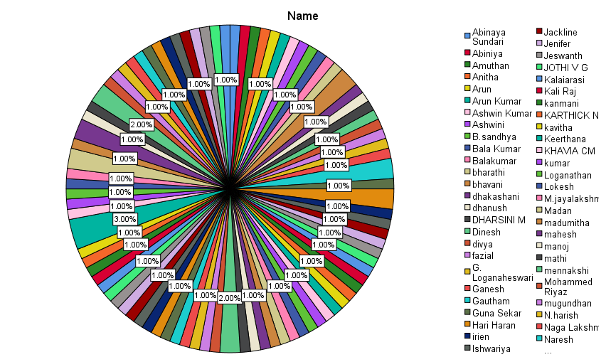

Slide 13
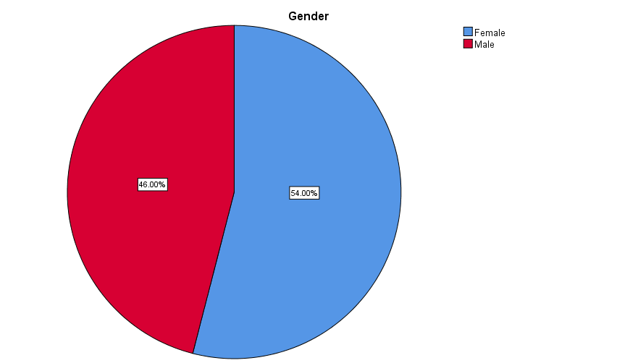

Slide 14
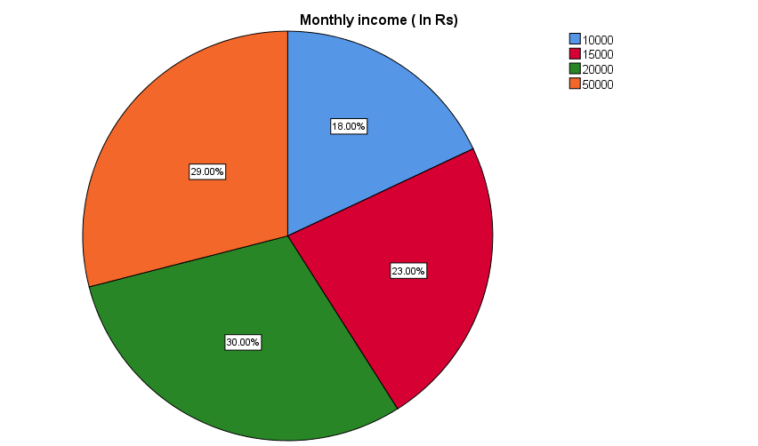

Slide 15
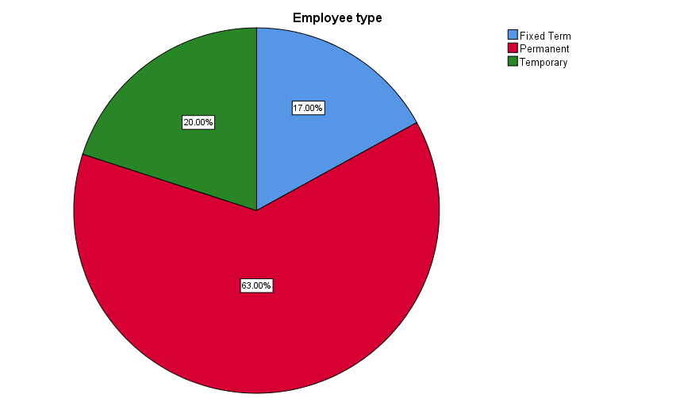

Slide 16
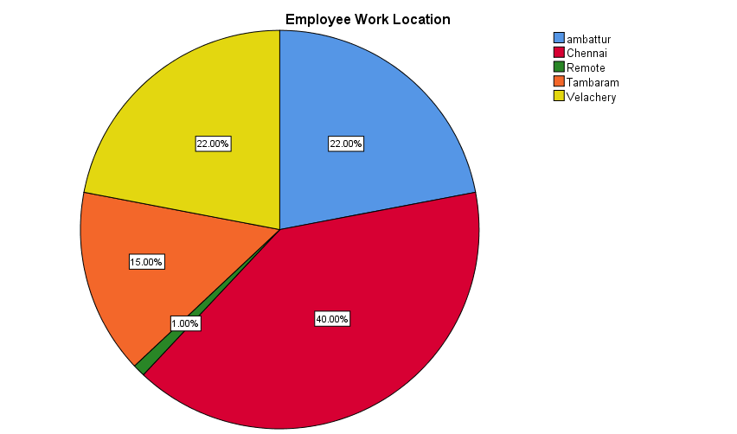

Slide 17
Conclusion
Summary of Insights: Recap of the main findings from the performance analysis. Implications: How these insights impact decision-making and strategy. Recommendations: Suggested actions based on the analysis (e.g., training programs, performance incentives). Future Work: Areas for further analysis or improvement in the data collection and analysis process.

